Slide 1
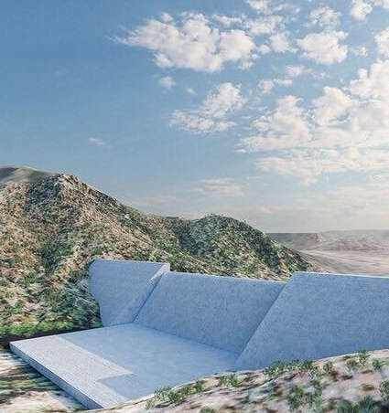
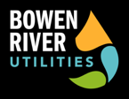
Growing North Queensland
Growing North Queensland
Project Overview
Information Booklet
October 2021

Slide 2
Disclaimer
IMPORTANT NOTICE
This document has been prepared to provide selected parties with a preliminary understanding of and to assist each recipient (“Recipient”) in making its own independent evaluation of Bowen River Utilities (“BRU”)’s proposal before deciding whether to pursue a potential investment. This document does not purport to be complete or contain all of the information that a prospective investor may require. While all reasonable efforts have been made to ensure the information contained in this document is accurate and correct at the date of its issue, no responsibility for any errors in, or omissions from, this document, whether arising out of negligence or otherwise, is accepted by BRU. This document is not a recommendation or an offer by BRU or any other person to invest. All enquiries in connection with this process should be directed to BRU.

Slide 3
Our Search for a Funding Partner
We are seeking suitable partners to help take our three projects through to operation
Inside this Document
Introduction to Bowen River Utilities (“BRU”) and our three projects:
Overview of current needs in North Queensland, and how BRU goes towards solving these through its projects
The underlying commercial opportunity – combined and by project
Our plans to develop the three projects
The opportunity to partner with BRU

Slide 4
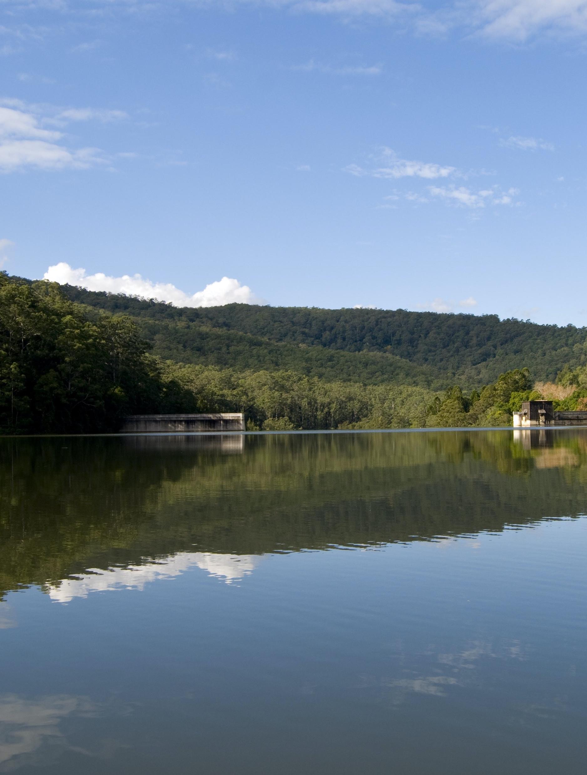
BRU Company Snapshot
BRU is the proponent for three major interlinked water, energy and food projects in NQ
Privately held Australian company
Developing three discrete but interlinked projects centred around the Urannah Dam in the Bowen region
Holder of long term real estate positions to develop infrastructure assets in NQ capturing value through the sale of water, energy and food production systems
Experienced team with strong track record in establishing infrastructure projects across Queensland
Completed concept, preliminary and detailed engineering and financial assessments for each of the three projects
Closely partnering with Federal, State and Local Government, local economic development agencies, First Nations people and communities

Slide 5
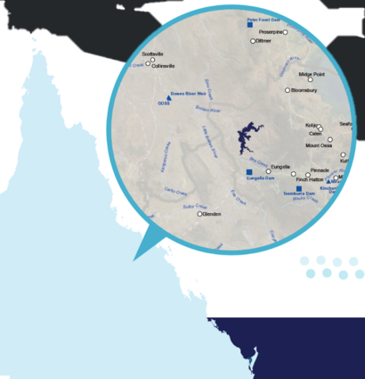
Our Three Integrated Projects
Our projects have a strong interlinked economic drivers and provide a great benefit to NQ
Project Locations
High Value Produce – 300ktpa
Local, Interstate and Export Markets
22,500Ha master-planned agricultural precinct
Green Electricity
Collinsville Irrigation
High Security Water – 86,000ML pa
Urannah Water Scheme
Bowen Renewable Energy Hub
Water Security
970,000ML dam
1,400MW – Hydro 500MW – Wind
Townsville
High Security Water – 20,000ML pa
Green Electricity – 4,100GWh pa
Mackay
Moranbah
Moranbah
National Electricity Market
Rockhampton
Internal Flow
External Flow

Slide 6
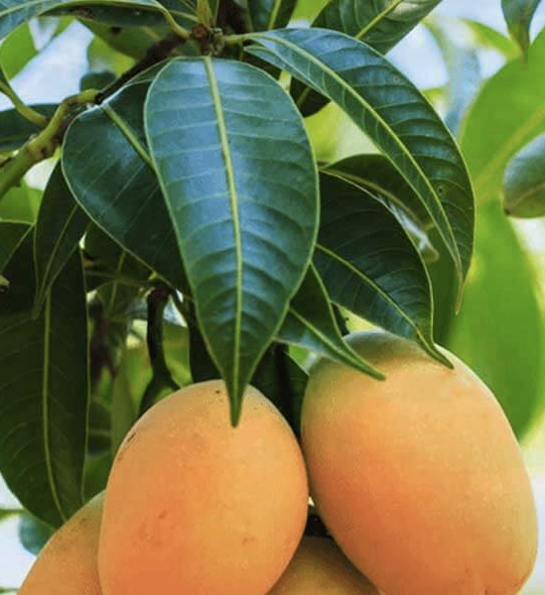
Our Long Term Vision
We want to establish critical infrastructure that will drive further opportunity in NQ
Bowen River Utilities’ key purpose is to develop opportunities for long term PPPs between key stakeholders across the three projects through:
Bringing together Private and Federal Government funding to build these key growth assets for North Queensland
Involving State Government as operators of the water and power assets through its GOCs
Unlocking large pools of capital for the benefit of Australia by enabling Australian managed funds to invest in local infrastructure assets, an opportunity that has not existed through privatisation of public assets in recent years
Partnering with local communities and First Nations people to ensure the assets provide significant opportunities for the local regions

Slide 7
Urannah Water Scheme
We are building a 970,000 ML dam to provide water security for the Bowen region
970,000 megalitre (ML) dam covering 5,926 hectares – almost double the size of Sydney Harbour
103,000 ML of High Priority water available per annum at >95% reliability – no other dam project can match this
Proposed catchment area receives significantly more rainfall, more frequently than nearby Eungella Dam – the reliability of this catchment provides very high confidence of water security
Strategically located to maximise reliability and yield for changing seasons and climate changes
20,000 ML per annum capacity pipeline to Moranbah – 7 key customers with EOIs
75 metre wall with Dam Crest at 285m AHD
0.95 Benefit Cost Ratio based on conservative government guidelines for the dam and infrastructure
State Significant Project Declaration by the State of Queensland

Slide 8
Bowen Renewable Energy Hub
We will have capacity to supply 11,375MWh of renewable energy per day
1.4GW renewable energy capacity from Pumped Hydro
Stage 1 – 3 x 300MW pumped hydro units producing 7,000MWh per day
Stage 2 – 2 x 250MW pumped hydro units producing 4,375MWh per day
Wind – 84 x 6MW wind units
Solar – up to 1.5GW of solar panels
Hydrogen – 200MW PEM
Largest renewable baseload energy project in Northern Australia, delivering dispatchable power to large electricity users across Queensland
Significant contributor to meeting Queensland’s 50% Renewable Energy Target by 2030
Supplied directly into the National Energy Market – superior location only 16km from NEM transmission line connection

Slide 9
Collinsville Irrigation Scheme
Development for prime horticultural and agricultural land
Master-planned agricultural precinct providing land, utilities and infrastructure, including high priority water licencing for 86,000ML per annum at >95% reliability
>9,000 hectares to be initially developed for high value cropping:
80% suitable for growing high value permanent fruit and nut crops
20% suitable for growing annual cereal and legume crops
Provides the Collinsville region the opportunity to become one of the key food bowls of Australia, creating jobs and delivering on the Federal Government’s 2030 vision for food security
Provides excellent geographic diversity for fresh produce suppliers looking to extend their seasons
Farming practices to align with the Commonwealth and Queensland Governments’ Reef 2050 Plan for the protection and management of the Great Barrier Reef
4 key properties to be acquired / farm shared

Slide 10
How BRU Will Help Meet North Qld’s Needs
Our projects will help meet NQ’s needs and provide a significant boost to the region
North Queensland’s Needs
BRU’s Solutions
Water Security
Provide confidence of consistent water supply to enable local industries to invest in future growth
Support NQ’s export ambitions across a range of industries
Reliable Low Cost Renewable Energy
Ensure ongoing grid stability as energy mix changes over time
Low electricity costs by using NQ’s natural assets to supply baseload renewable energy into the National Electricity Market
Employment Opportunities
Long-term job transition and growth with roles in construction, manufacturing, logistics, agriculture and tourism to encourage people to live and stay in the region
Food Supply
Support Australia’s commitment through the Ag2030 target to grow the value of Australia’s agricultural production to $100 billion by 2030 and ensure food security across Australia
Take advantage of NQ’s geographic diversity and excellent growing conditions to complement and enable extension of Southern Australia and overseas growing seasons
The Urannah Water Scheme, Bowen Renewable Energy Hub and Collinsville Irrigation Scheme are nation building projects, delivering a plan for the future and supporting the Mackay, Whitsunday and Isaac region communities as they continue to grow.
The UWS will change the way water is thought about in the region. High security water will become available to the industries that need it to provide vital ongoing economic growth. The UWS will deliver water security for at least 30 active projects and 71 new projects, creating significant job opportunities.
The delivery of a new bulk water source for NQ will create the next generation of utilities that enable communities to prosper through sustainable water and energy supply. It will diversify the Northern Australian regional economy.
The BREH will establish the largest renewable baseload energy project in Northern Australia, reducing carbon emissions, taking full advantage of existing natural assets and leading the way for hundreds of other renewable energy projects, making North Queensland an energy sector leader.
Through the CIS, farmers and large-scale agriculture producers will have access to a master-planned irrigation scheme, opening up opportunities to grow high-value crops and facilitate export opportunities, creating jobs and delivering on a vision for food security not only for the region, but across Queensland and Australia.

Slide 11
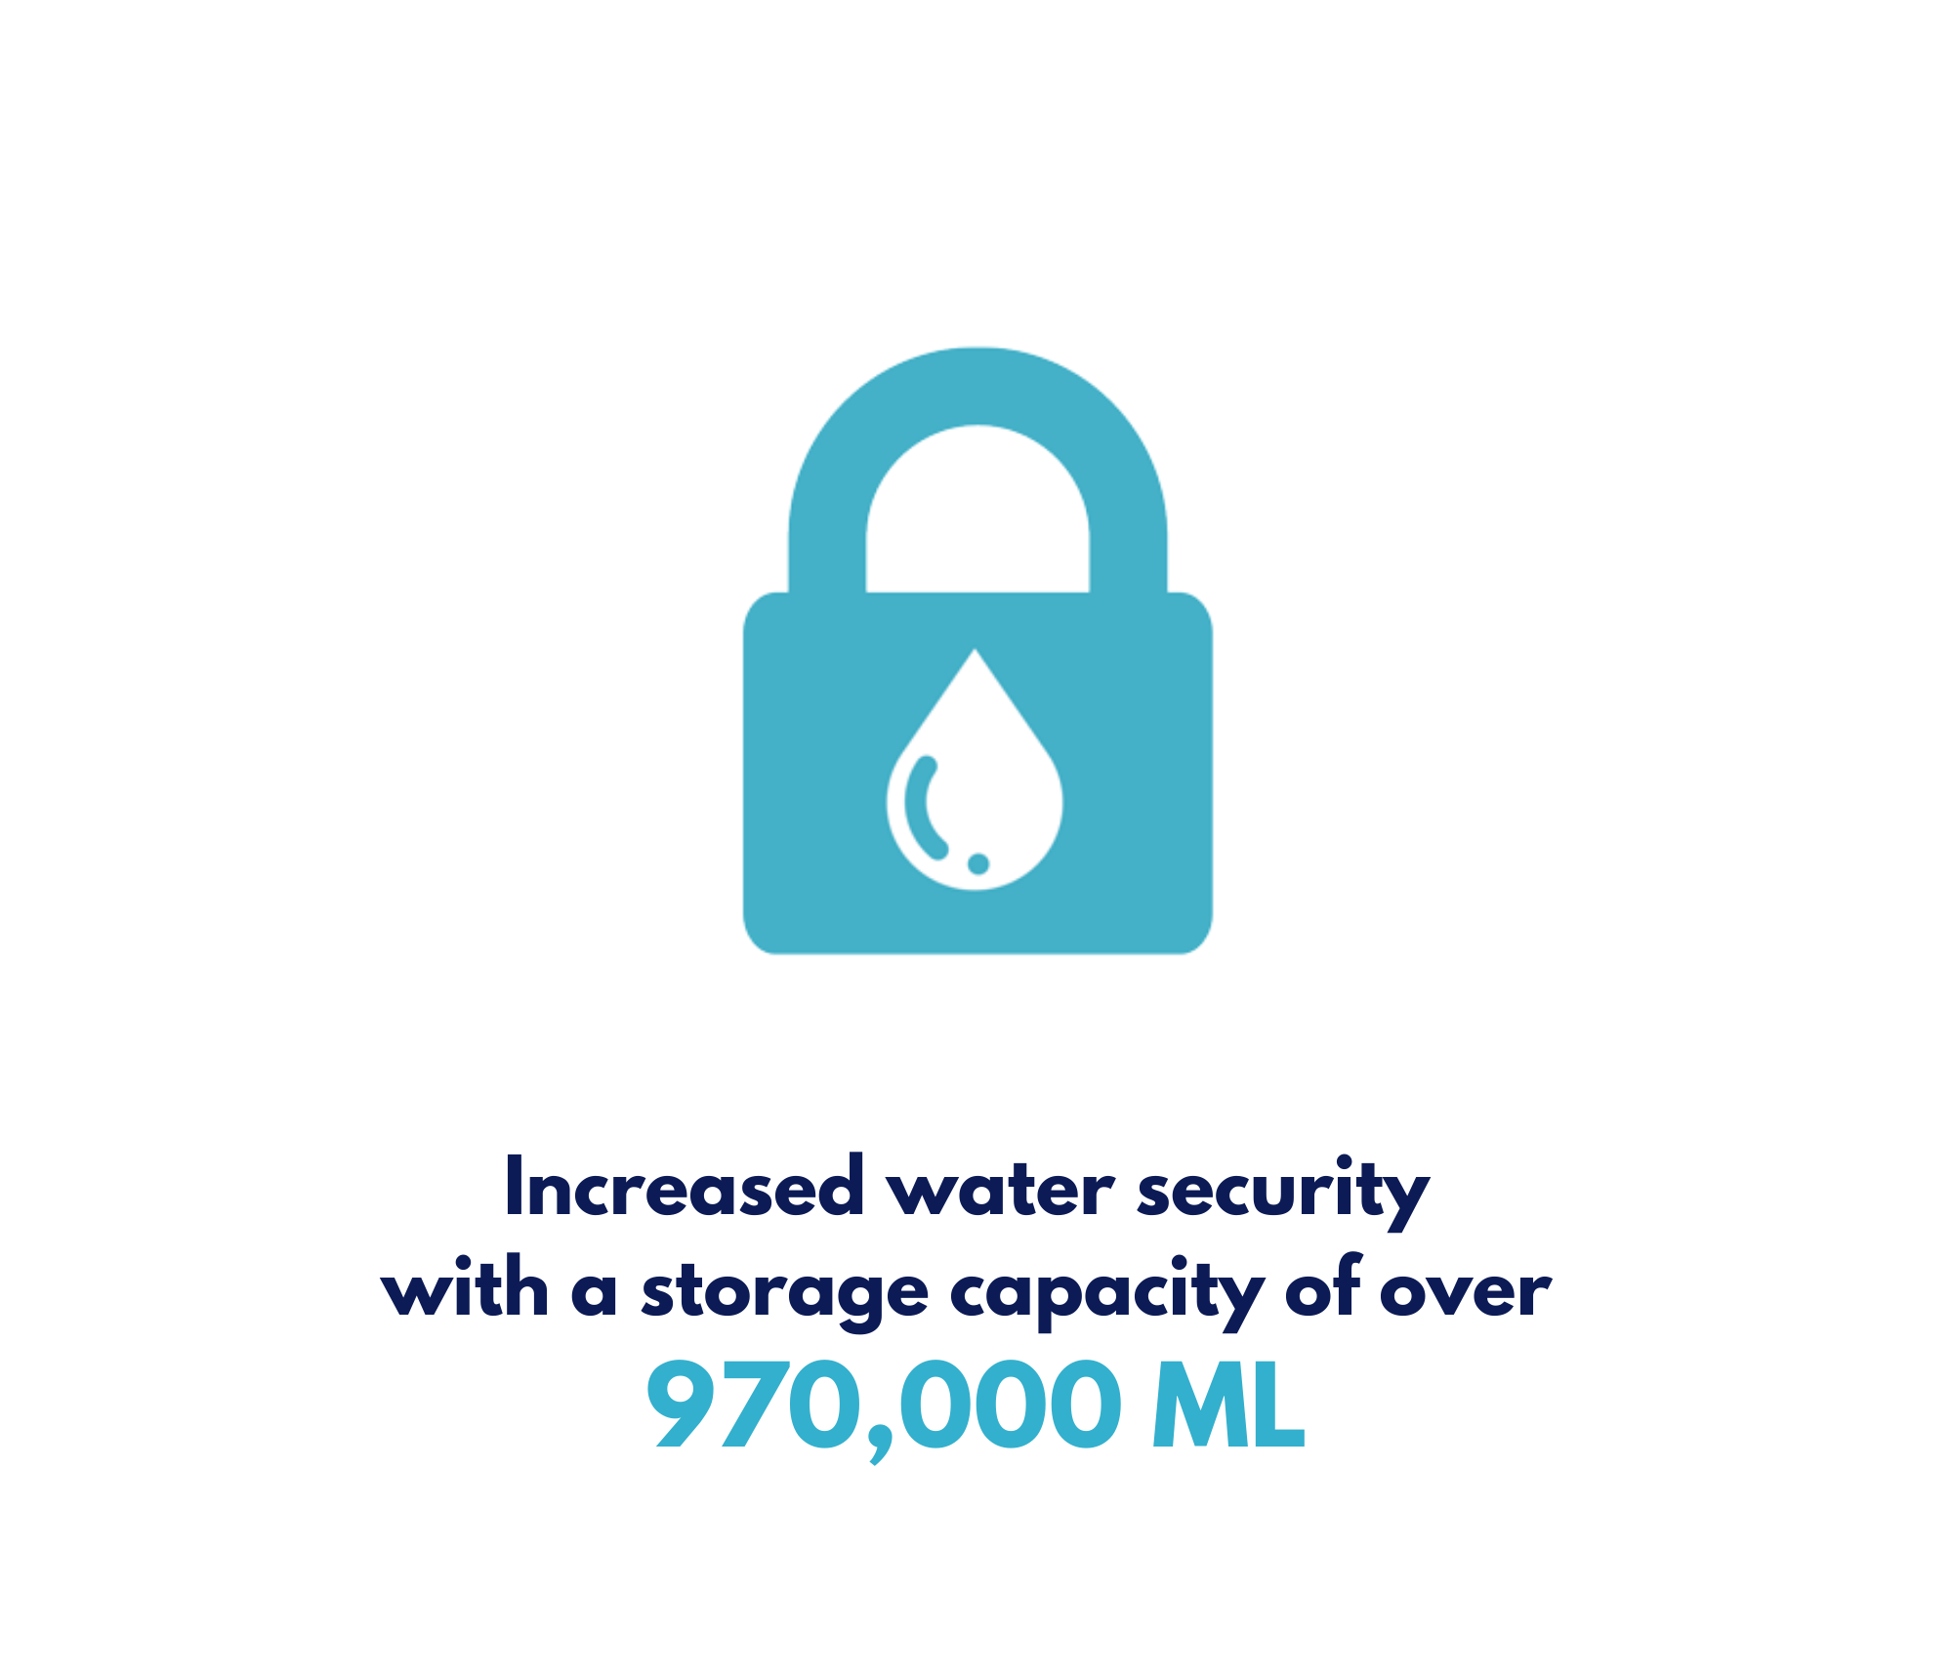
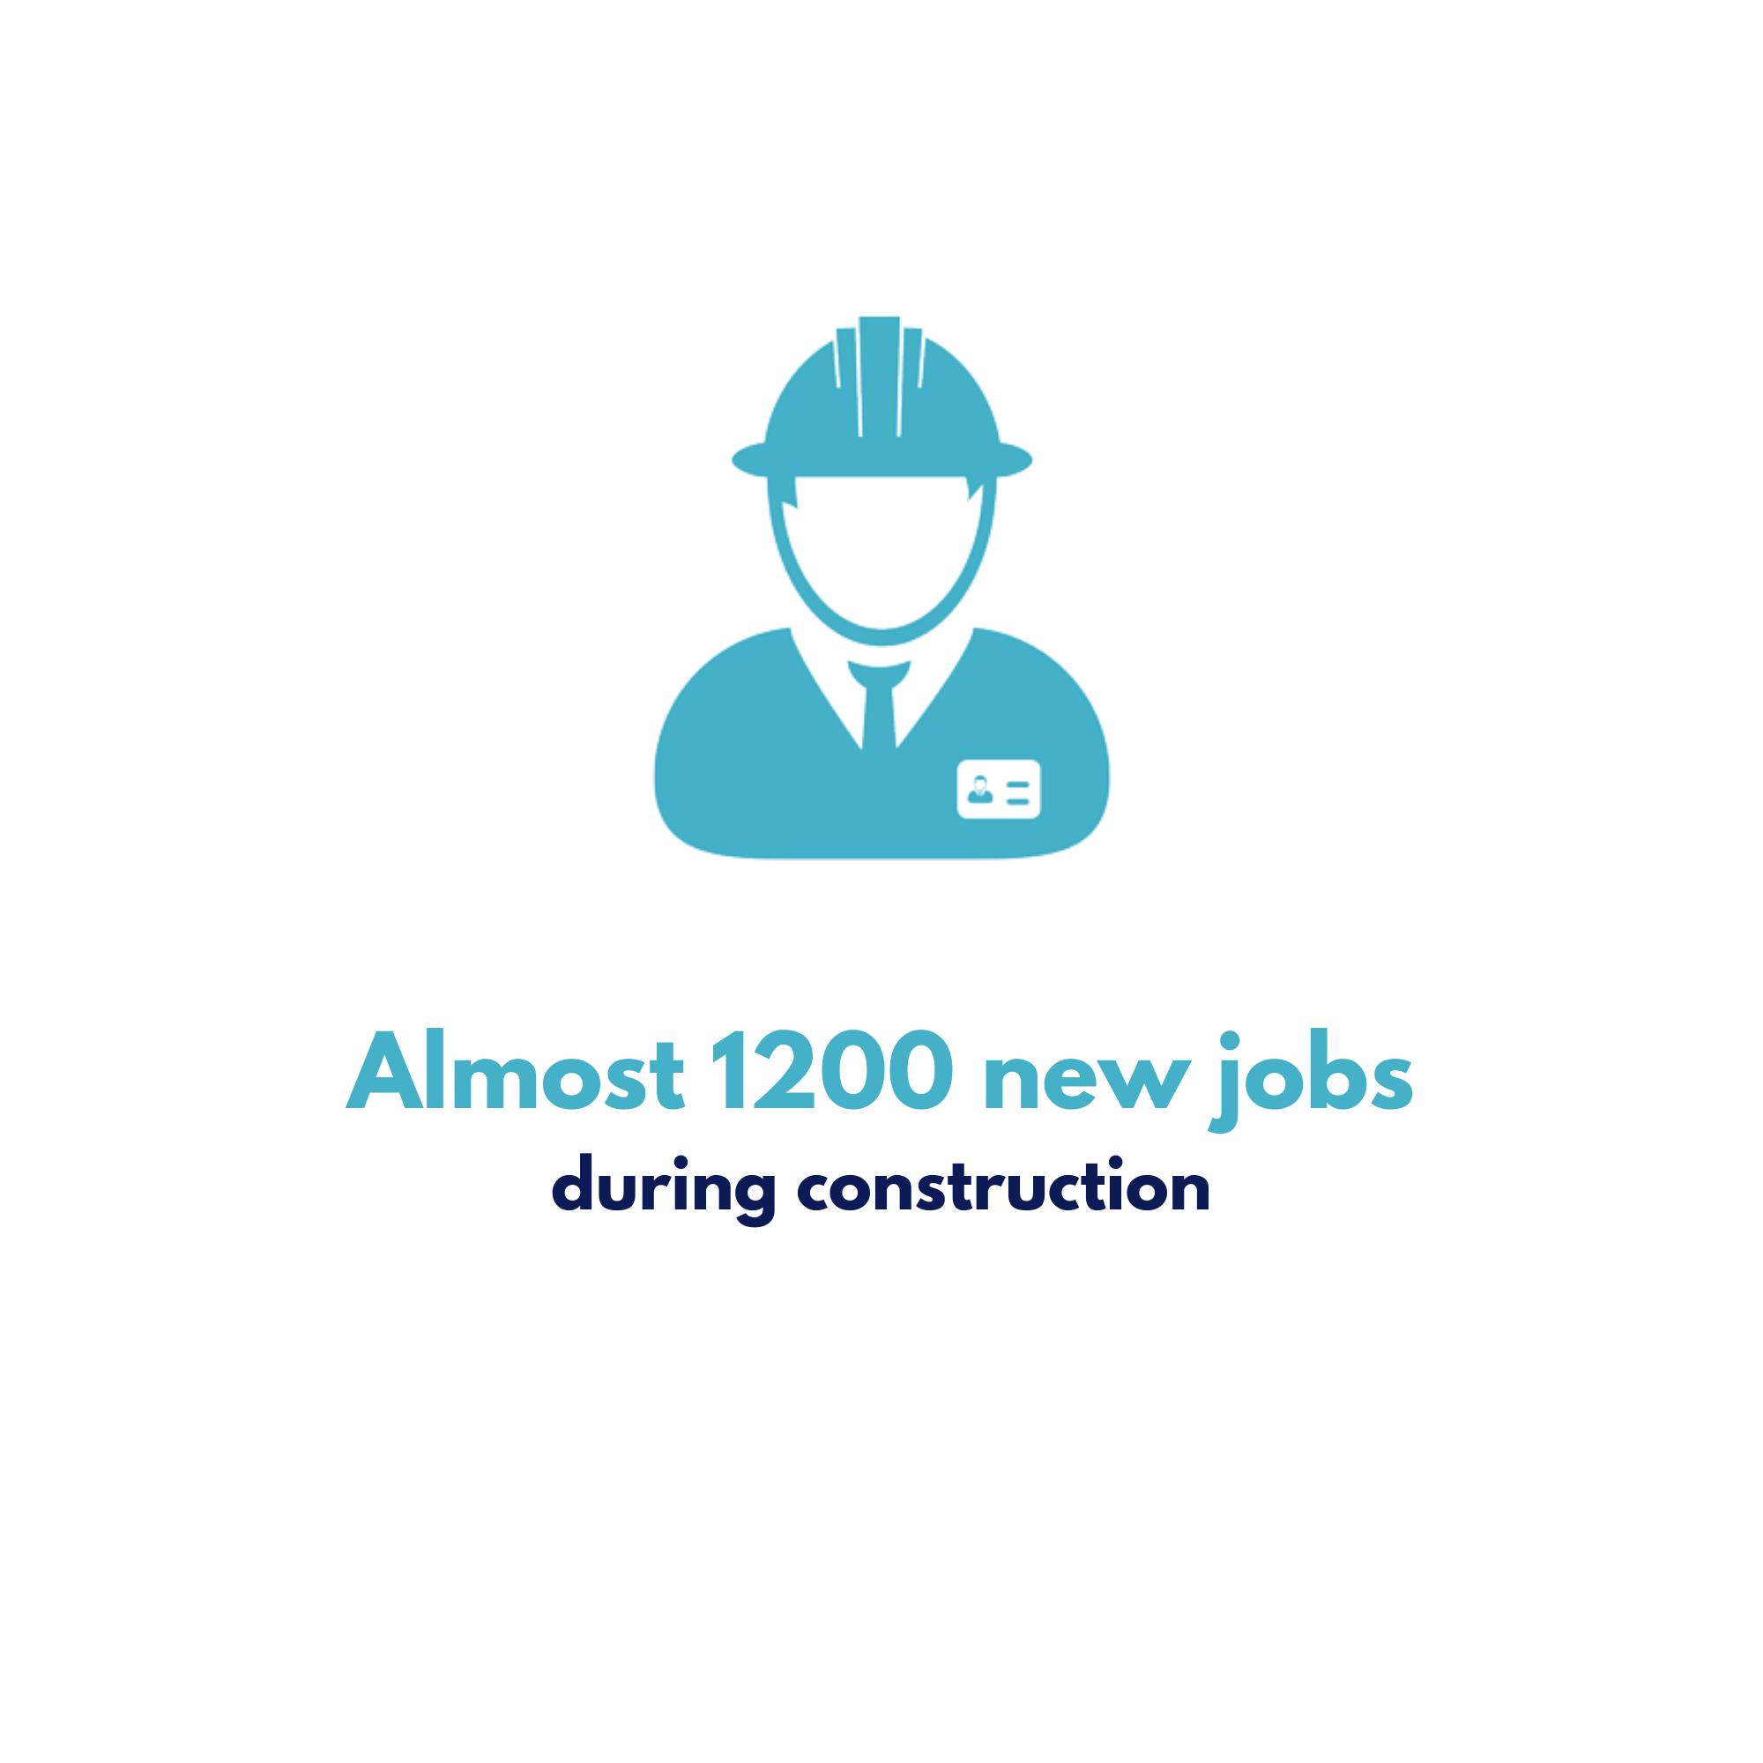
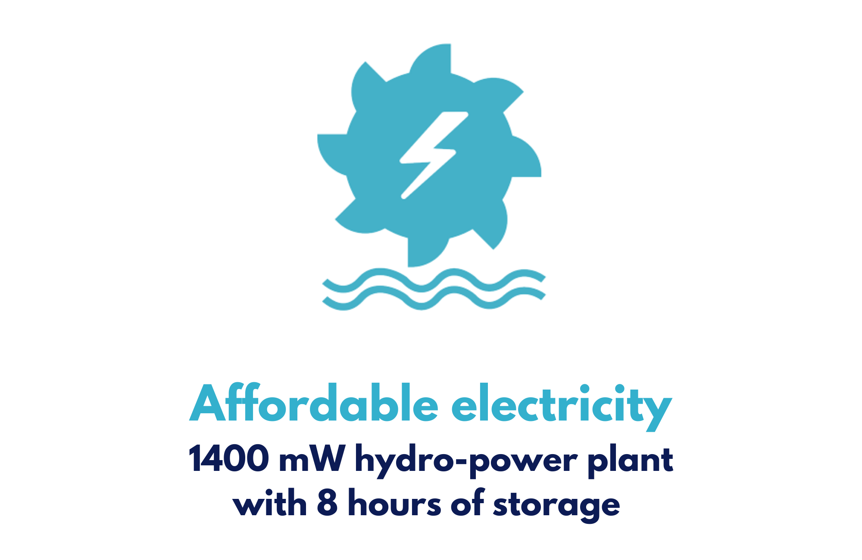
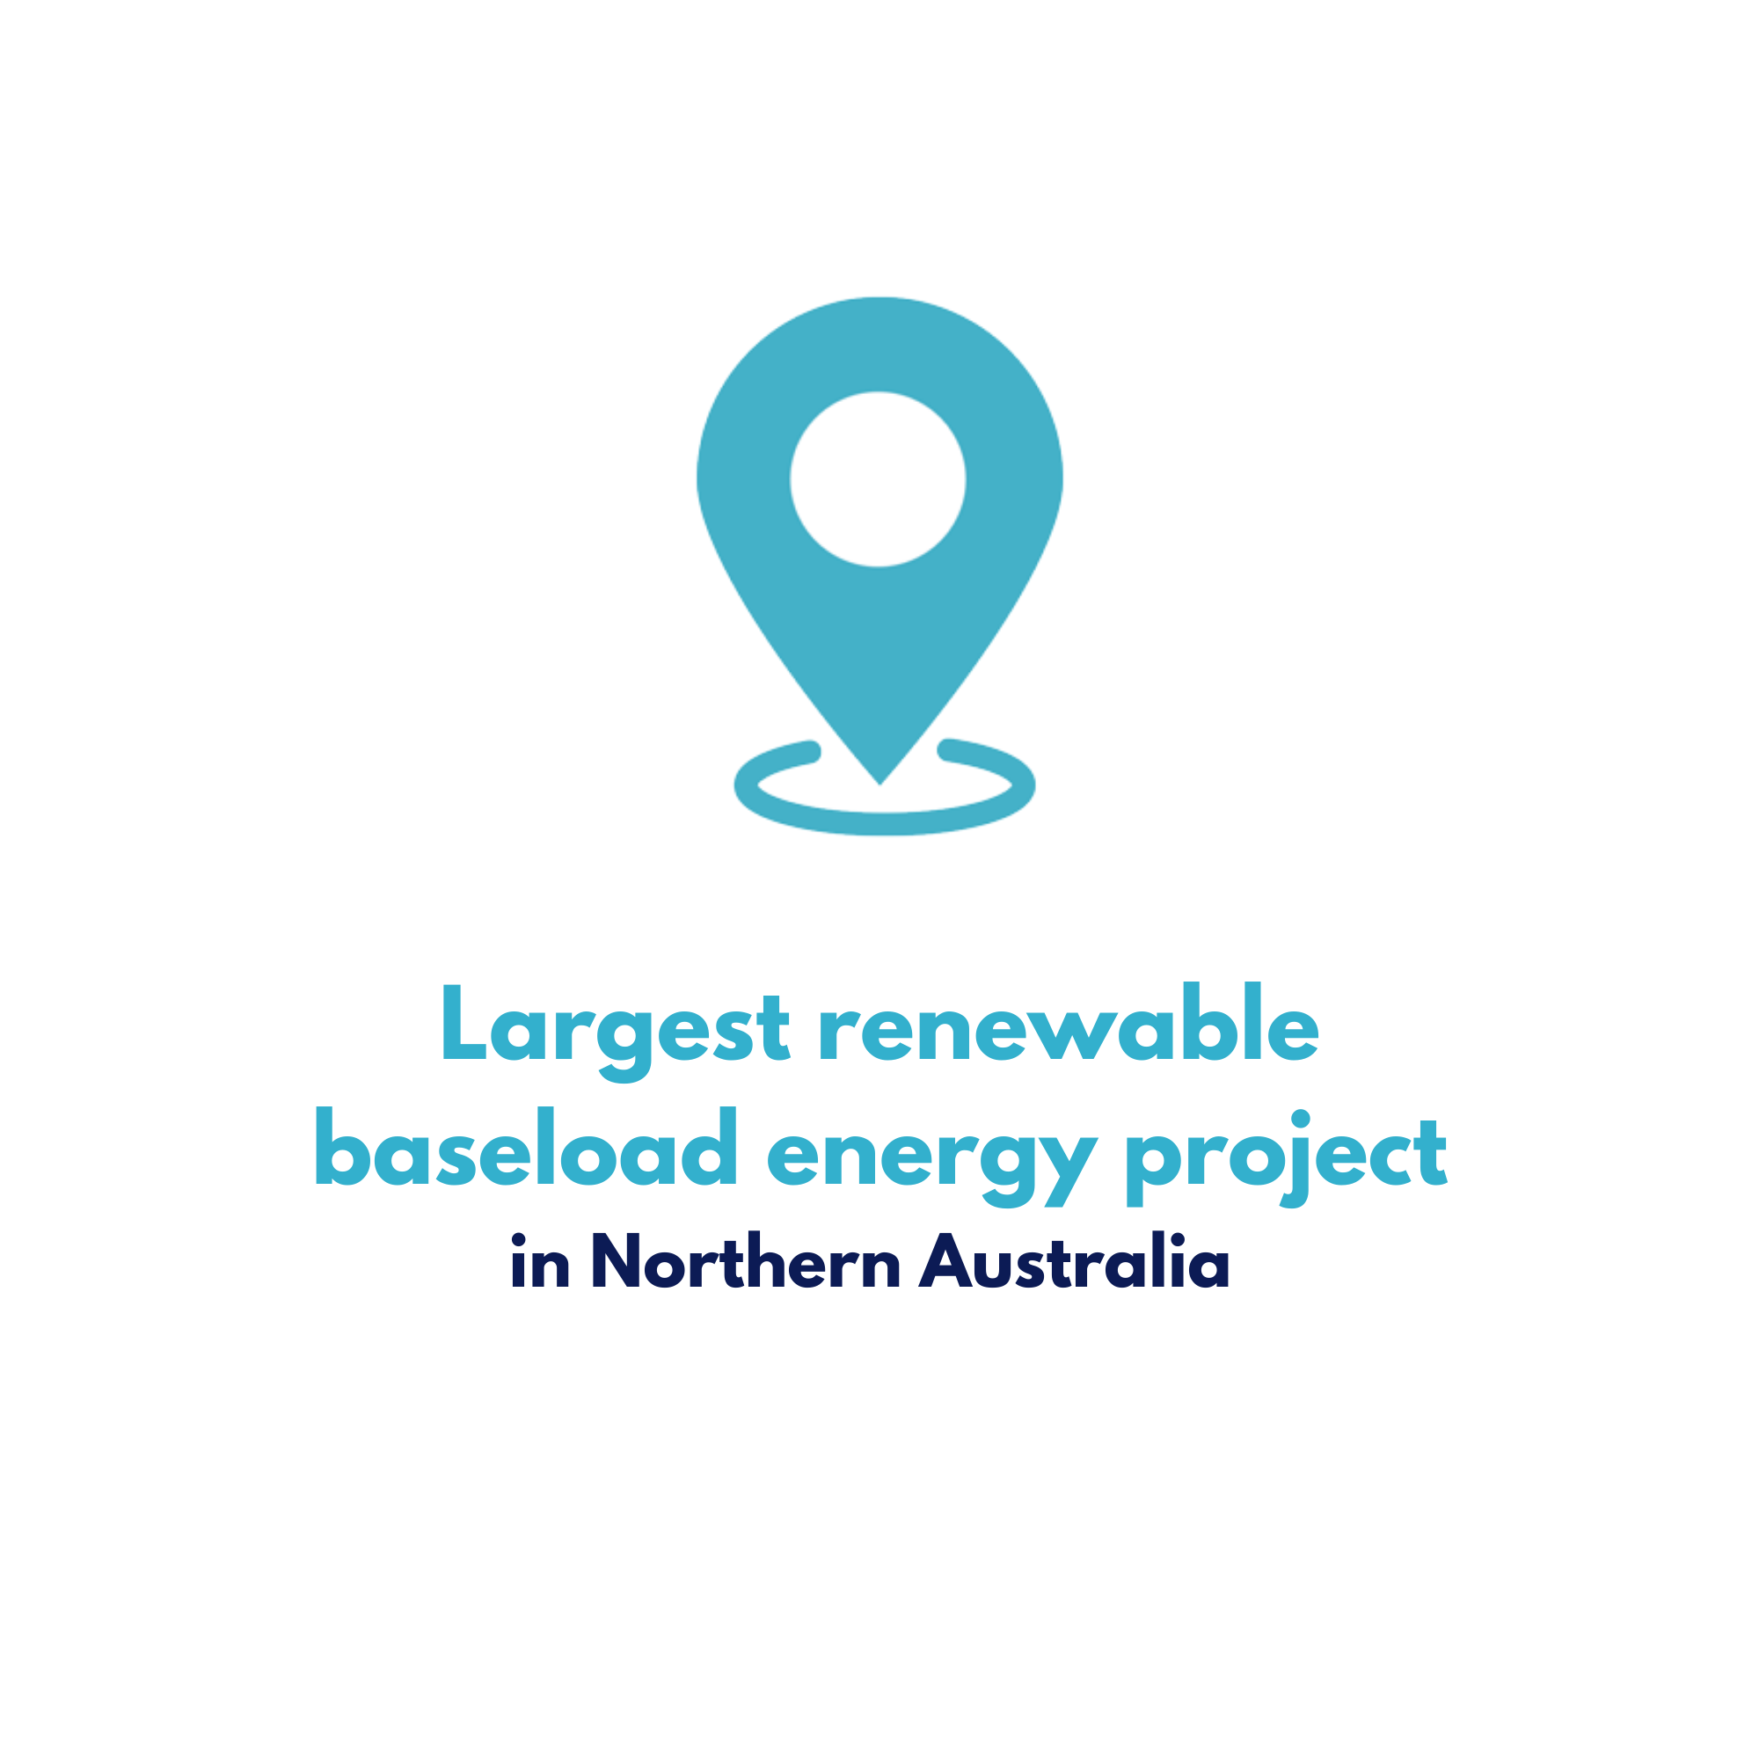
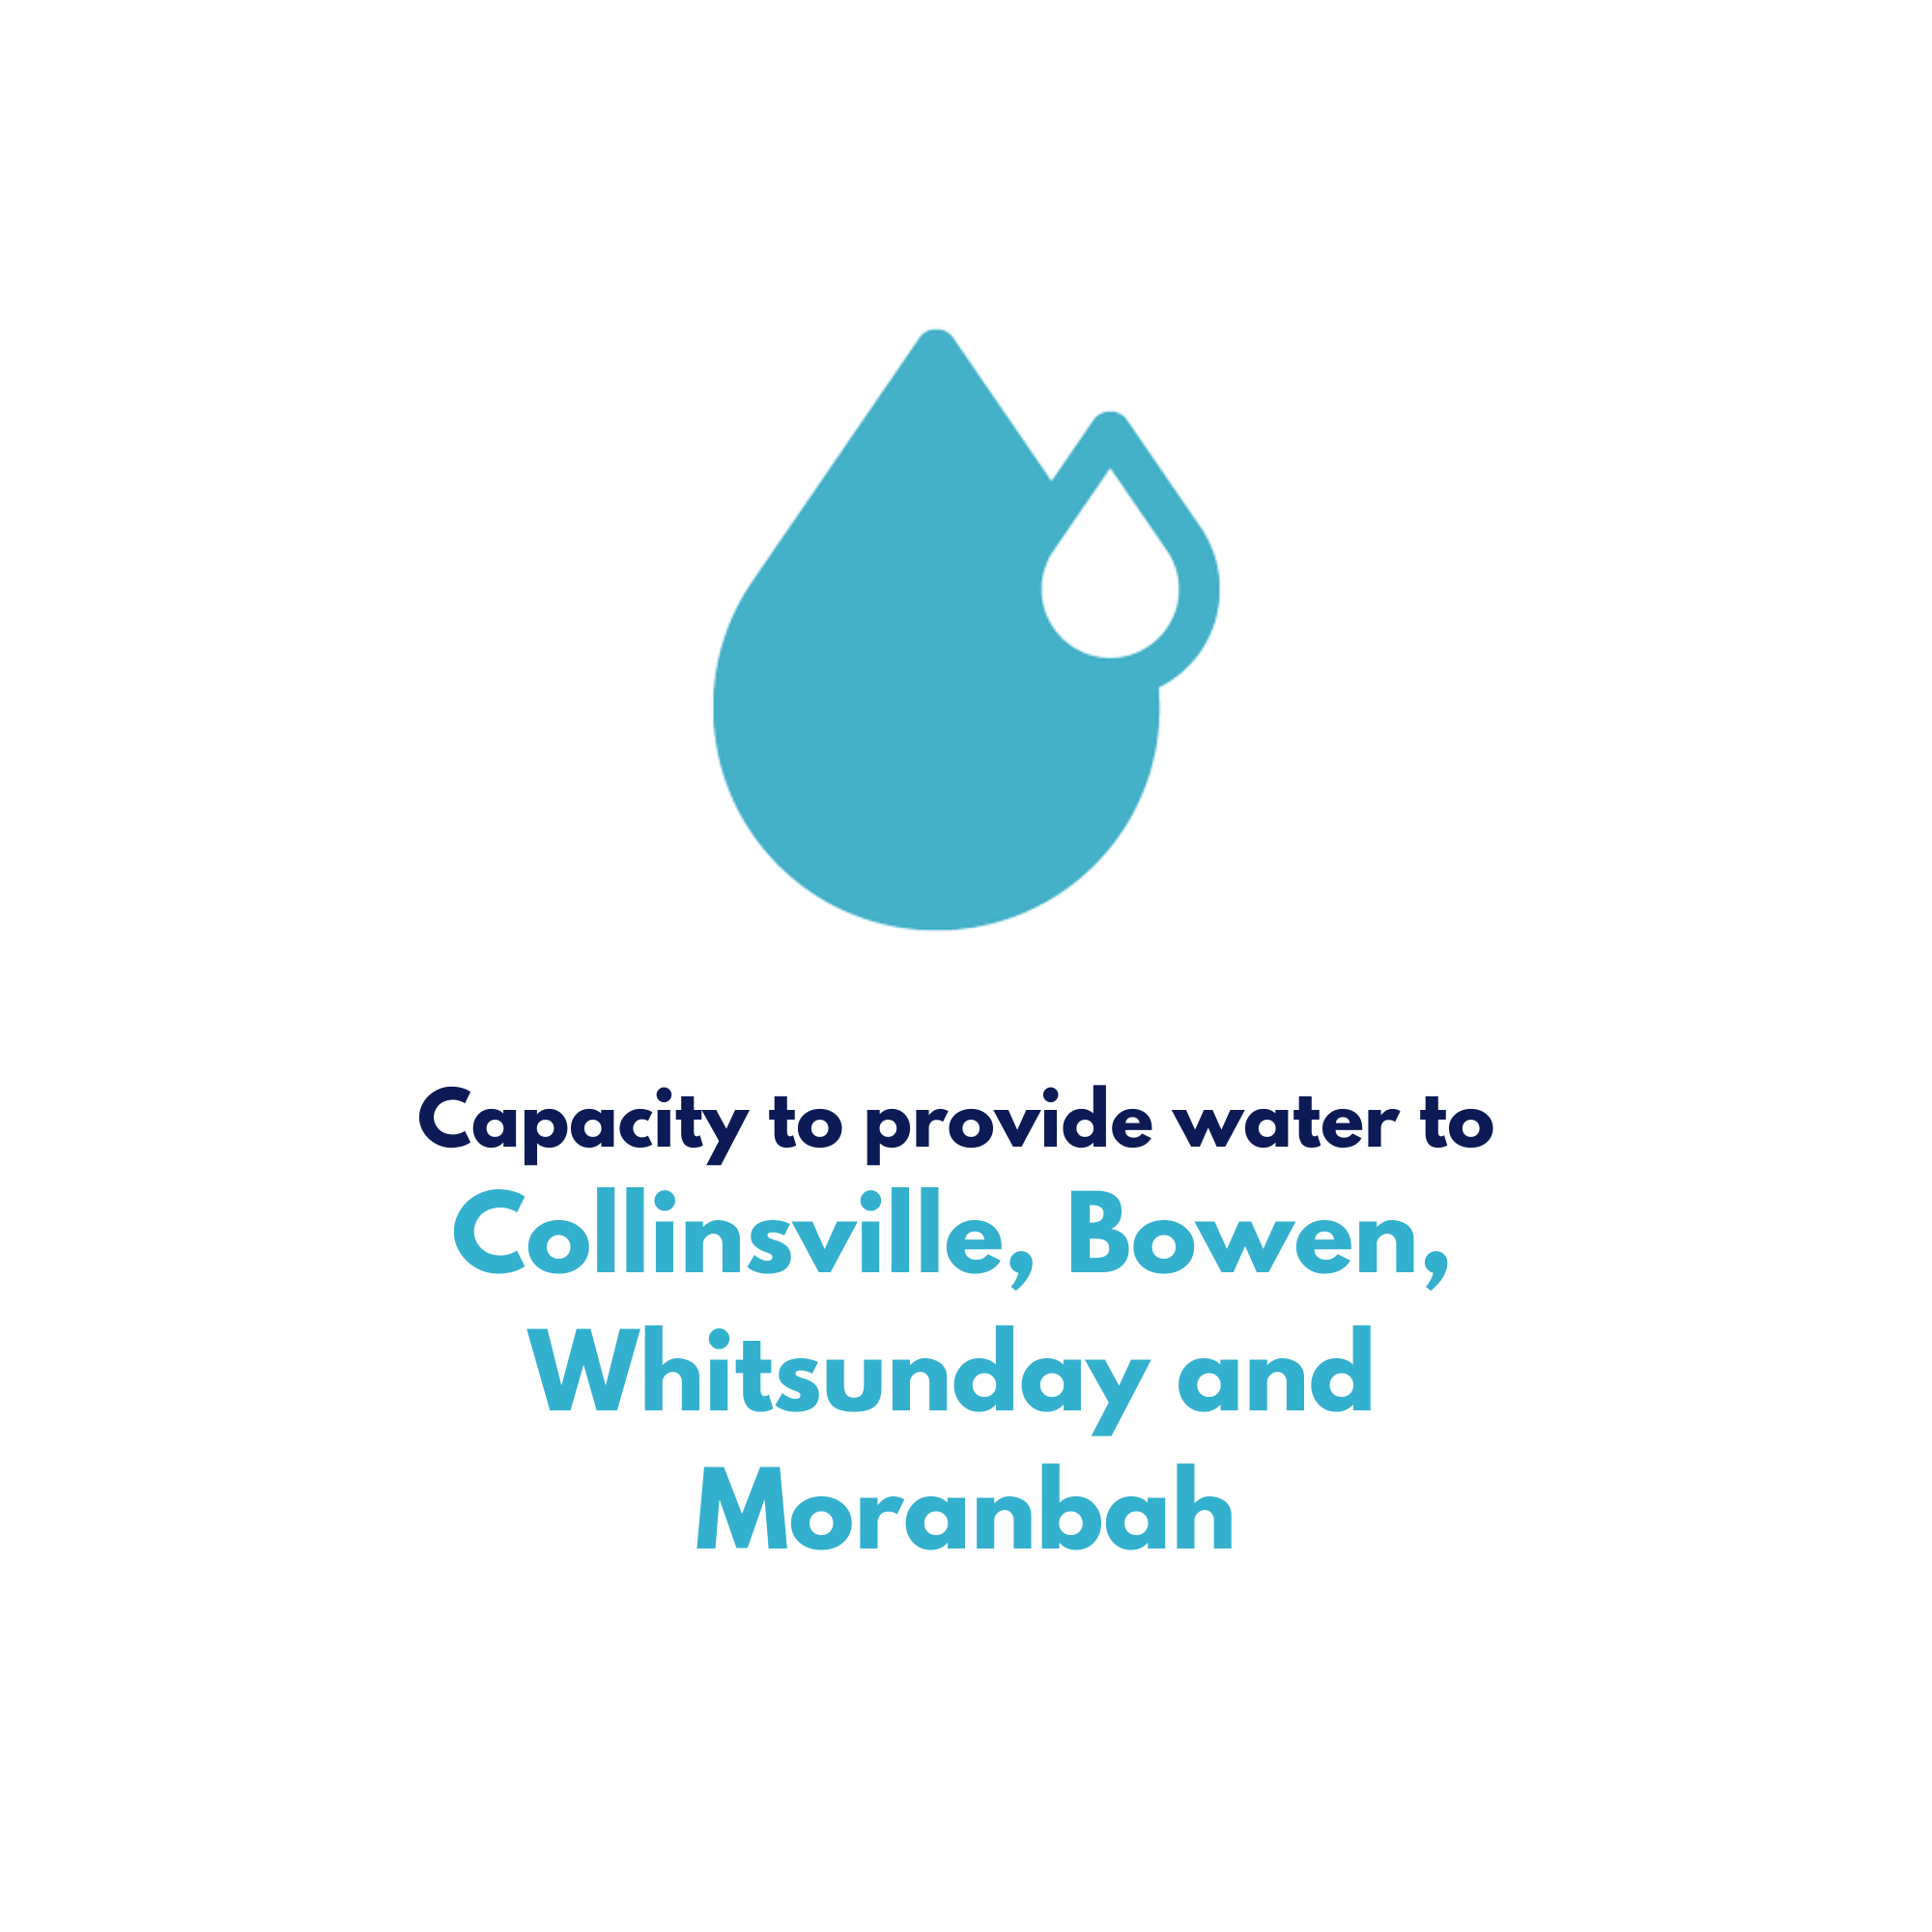
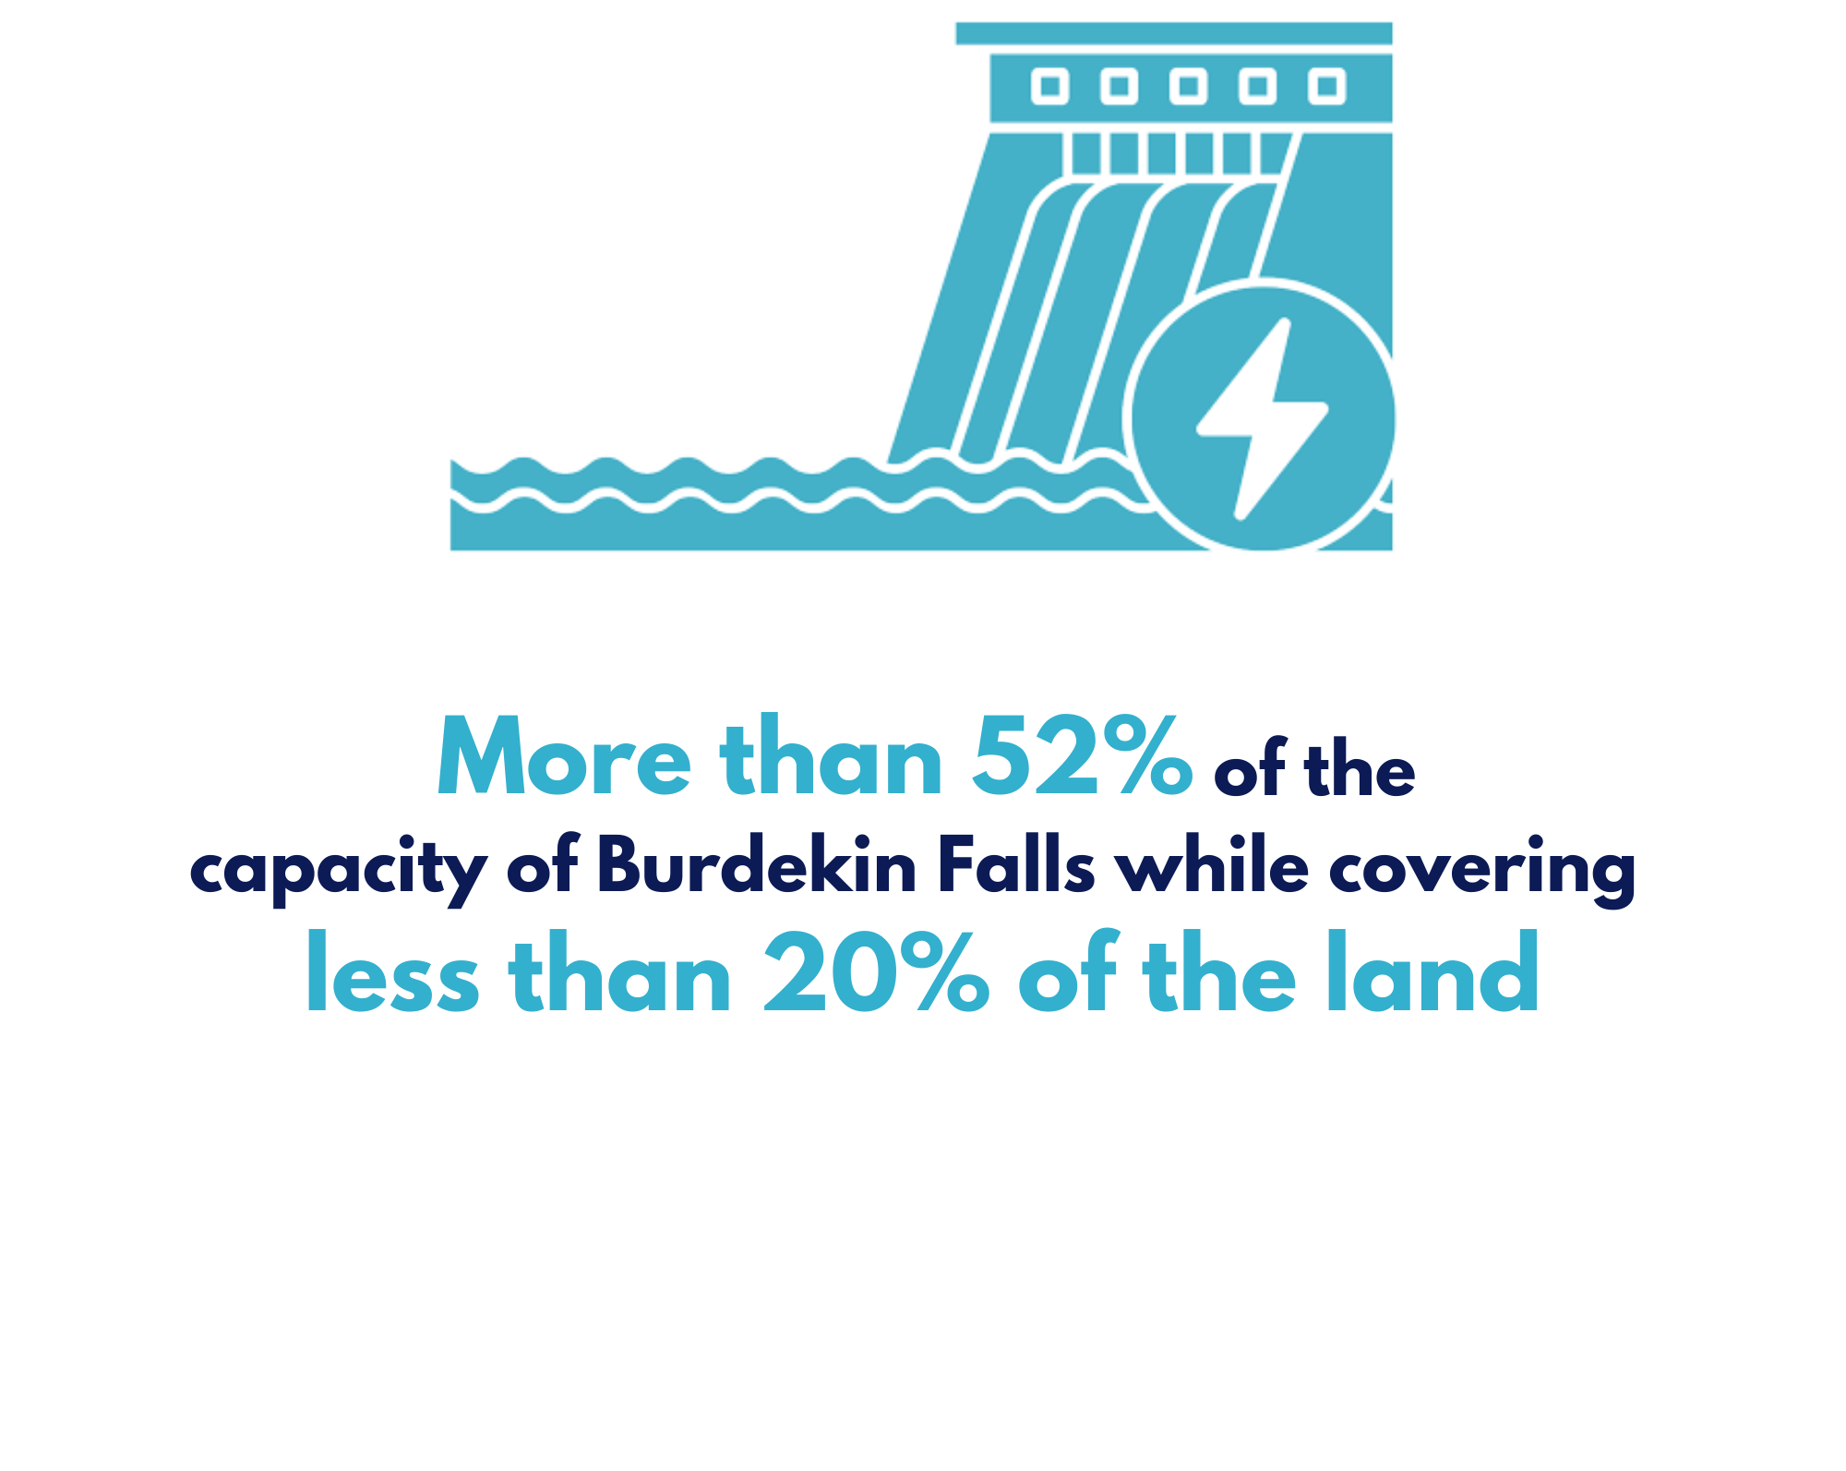
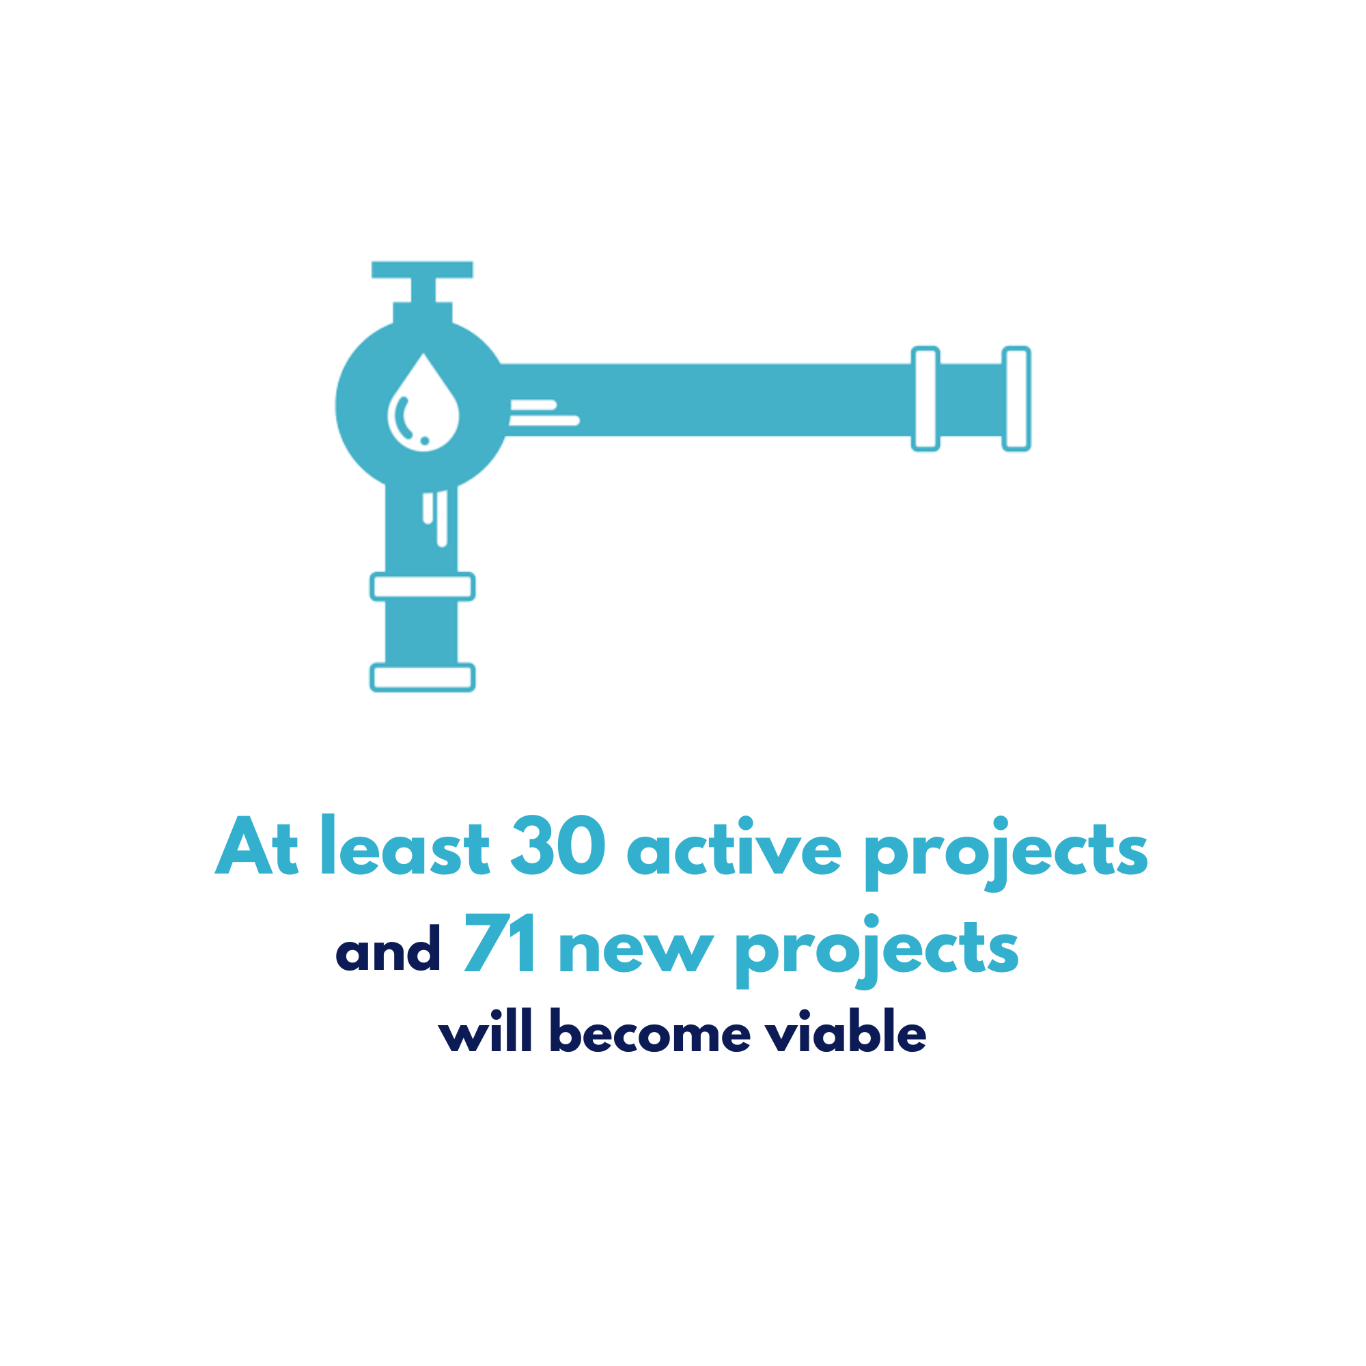
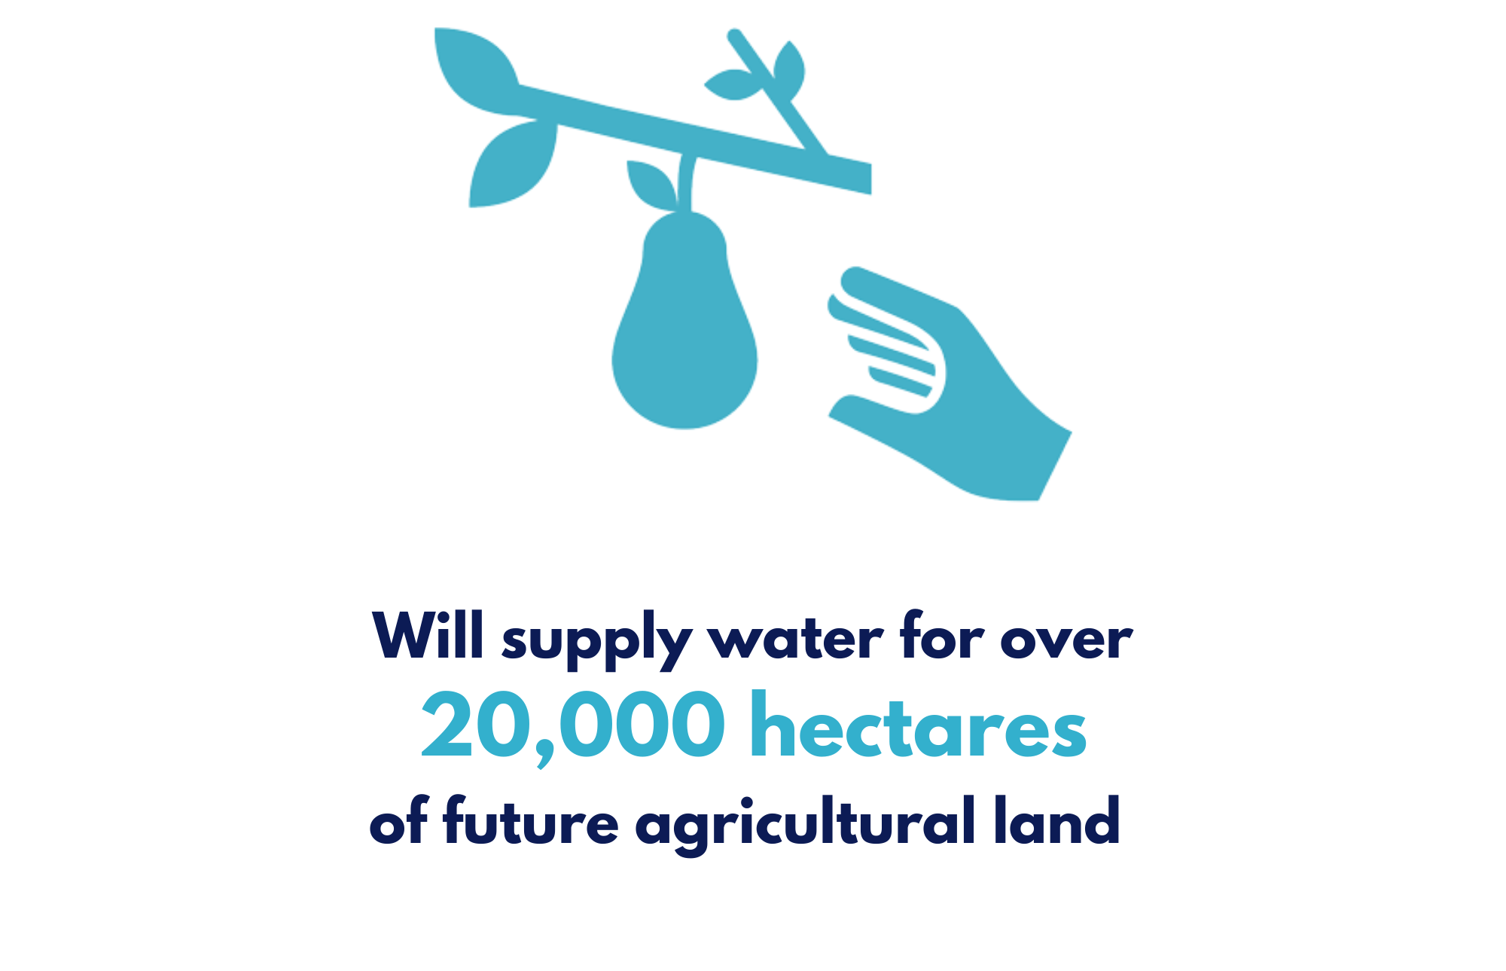
Community and Regional Benefit
Our projects will boost the NQ economy and have strong support from the community

Slide 12
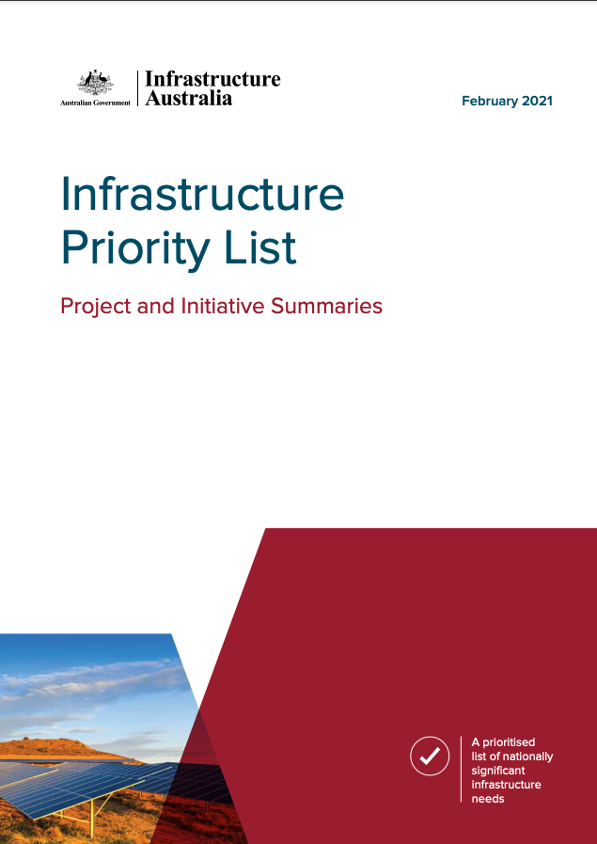
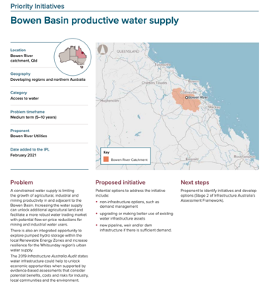
Government Endorsement
Our projects address critical priorities for both the Federal and State government
Listed as a Priority Initiative on Infrastructure Australia’s 2021 Priority List
Strategic Reserve under the Water Resource (Burdekin Basin) Plan
Urannah Water Scheme project received State Significant Project Declaration by the State of Queensland
$13m in grants for Feasibility Studies provided by Federal Government through the National Water Infrastructure Fund
$2m in grants provided by Federal Government through the Supporting Reliable Energy Infrastructure Program
$460m budget submission and full business case provided for Federal Government funding consideration through the National Water Infrastructure Fund – funding commitment expected in May 2021 Federal Budget
Strong support and endorsement by Federal and State Ministers, including Deputy Prime Minister, Michael McCormack

Slide 13
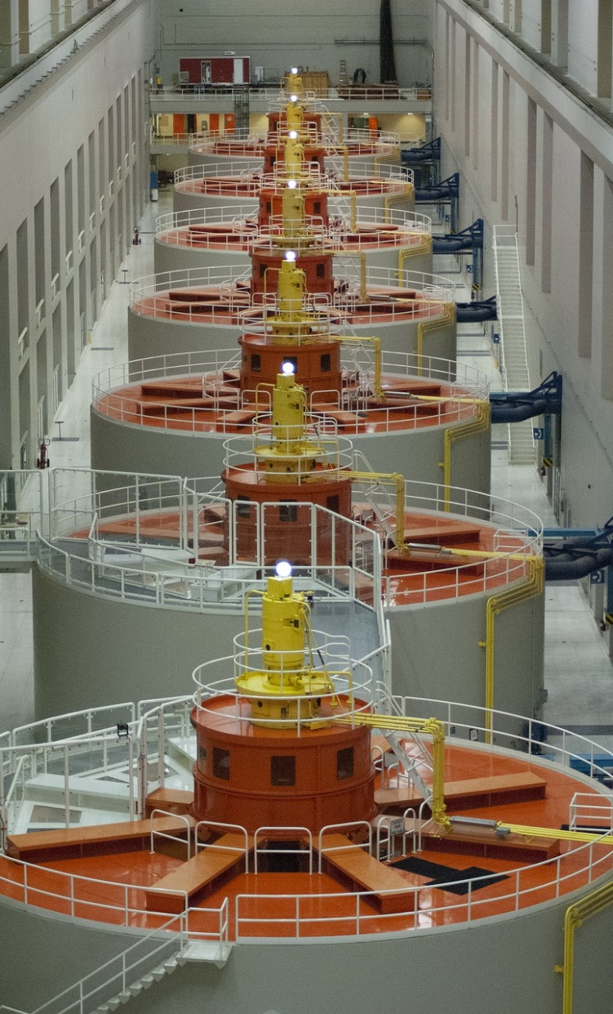
Ticking Milestones
We are well down the path to financial closure and have completed a draft EIS
Major achievements to date:
 | 2015 | Established highly experienced project teams with specification, design, customer engagement and project management processes underway
 | 2016 | Completed strategic and pre-feasibility study and commenced baseline environmental studies
 | 2018 | Secured options on land holdings required for development of Urannah Water Scheme, Hydro and Collinsville Irrigation Scheme Projects
 | 2020 | Completed detailed Feasibility Study for Urannah Dam
 | 2020 | Received endorsement from Federal and State Ministers
 | 2020 | Declared a State Significant Project and completed preliminary EIS for Urannah Water Scheme
 | 2021 | Completed Detailed Business Case for Urannah Water Scheme
 | 2021 | Completed detailed Pre Feasibility Study for Bowen Renewable Energy Hub
 | 2021 | Completed detailed Feasibility Study for Collinsville Irrigation Scheme
 | 2021 | Commenced detailed Feasibility Study for Bowen Renewable Energy Hub

Slide 14
The Right Opportunity in the Right Location
This investment is backed by sound fundamentals, many which are unique to NQ
Availability of large greenfield site located in a high rainfall area (almost double that of the broader region) where the water is needed with very high reliability, addressing long term climatic variations
Cropping areas with limited severe weather events and in a single precinct, enabling food development in the region to be balanced with Great Barrier Reef impact management practices
Need for bulk low carbon electricity capacity firming as energy mix changes
Close proximity to the National Electricity Market transmission network
Long term industrial customers in close proximity to proposed dam, with positive demand outlook
Attractive agricultural precinct and opportunity to add value through securing water delivery
Strong Federal and State Government focus on water, electricity and regional economic diversity
Long term Regulated Asset Base implications on State Government electricity and water providers with aging asset bases
Large scale community and economic development agency support
Deep and meaningful First Nations people support and partnerships

Slide 15
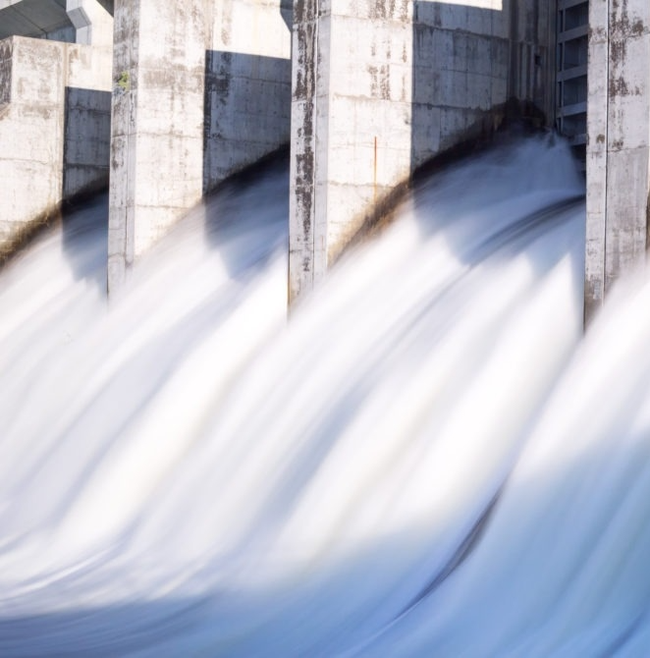
Closing
Where does our vision align, and where to we differ?
Having reviewed this document, we seek your thoughts on the points below. Where does our vision align, and where do we differ?
Community need and support for the projects
Opportunity provided by growth in demand for high priority water, renewable electricity and fresh produce
Levels of Federal and State government and financial support
Company structure
Strong business case with attractive returns for long term infrastructure projects
Approach to achieving financial close by the end of 2022

